Slide 1
Lecture 5 Class & Object (Part 2)
Object Oriented Programming

Slide 2
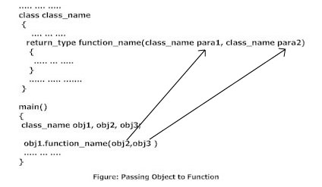
Object as Function Argument:
Procedure to Pass
Object to Function
In C++ programming, objects can be passed to function in similar way as variables and structures.

Slide 3
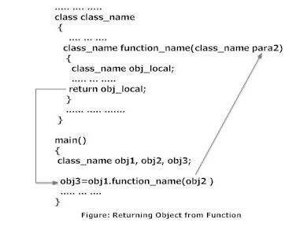
Returning Object from Function
Object as Function Argument:
Returning Object from Function
The syntax and procedure to return object is similar to that of returning structure from function.

Slide 4
Object as Function Argument:
class Complex
{
private:
int real;
int imag;
public:
void Read() {
cout<<"Enter real and imaginary number respectively:"<<endl;
cin>>real>>imag;
}
void Add(Complex comp1,Complex comp2)
{
real=comp1.real+comp2.real;
imag=comp1.imag+comp2.imag;
}
void Display()
{
cout<<"Sum="<<real<<"+"<<imag<<"i";
}
};
int main()
{
Complex c1,c2,c3;
c1.Read();
c2.Read();
c3.Add(c1,c2);
c3.Display();
return 0;
}

Slide 5
Parameterized Constructor
C++ permits us to achieve the objects but passing argument to the constructor function when the object are created. The constructor that can take arguments are called parameterized constructors
Definition
class abc { int m,n; public: abc(int x,int y); //parameterized constructor ................ ................. }; abc::abc(int x,int y) { m=x;n=y; }
Example

Slide 6
Parameterized Constructor
#include<iostream>
using namespace std;
class Example
{
int a,b,c;
public:
Example(int x,int y,int z)
{
a=x;
b=y;
c=z;
cout<<"This is Constructor\n";
}
void Display()
{
cout<<"Values :"<<a<<"\t"<<b<<"\t"<<c;
}
};
int main()
{
Example Object(10,20,30);
Object.Display();
return 0;
}

Slide 7
Constructors Overloading
Constructors Overloading are used to increase the flexibility of a class by having more number of constructor for a single class. By have more than one way of initializing objects can be done using overloading constructors.

Slide 8
Constructors Overloading
#include<iostream>
using namespace std;
class cpy
{
int var,fact,real;
public:
cpy(int temp)
{
var=temp;
}
cpy(){}
cpy(int a, int b){
fact=a;
real=b;
}
void calculate()
{
cout<<var<<endl;
}
void calculate1()
{
cout<< fact+ real;
}
};
int main()
{
int n,m;
cout<<"Enter the Number : ";
cin>>n>>m;
cpy obj;
cpy obj1(n);
cpy obj2(n,m);
obj.calculate();
obj1.calculate();
obj2.calculate1();
return 0;
}

Slide 9
Destructor
It is used to destroy the object that has been created by a constructor.
It is a member function whose name is the same as the class name but is preceded by tilde (~) symbol.
A class can’t have more than one destructor. It takes no arguments and no return types can be specified for it (not even void).
It is called automatically by the compiler when an object is destroyed.
The general syntax of the constructor and destructor is:-
Class Class_name { Private: Public: Class_name (); // constructor ~Class_name (); //destructor };

Slide 10
Need of destructor
Constructor allocates memory to the object. This allocated memory must be de-allocated before the object is destroyed.
This job of memory de-allocation from object is done by special member function of the class. This member function is destructor.
Hence, the most common use of destructor is to de-allocate and release memory that was allocated for the object by the constructor.

Slide 11
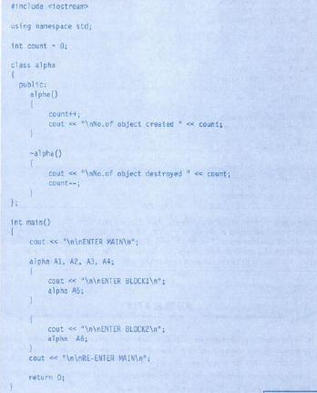
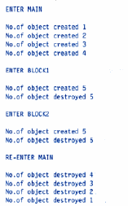
Programming Example

Slide 12

Programming Example
#include <iostream>
using namespace std;
class MyClass
{
public:
int x;
MyClass(); // constructor
~MyClass(); // destructor
};
// Implement MyClassconstructor.
MyClass::MyClass()
{
x = 10;
}
// Implement MyClass destructor.
MyClass::~MyClass()
{
cout<< "Destructing ...\n";
}
main()
{
MyClass ob1;
MyClass ob2;
cout <<ob1.x<< " " <<ob2.x<<"\n";
}

